Slide 1
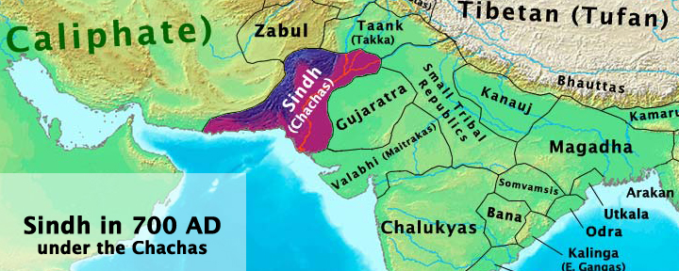
Conquest of Sindh
Pakistan Studies

Slide 2
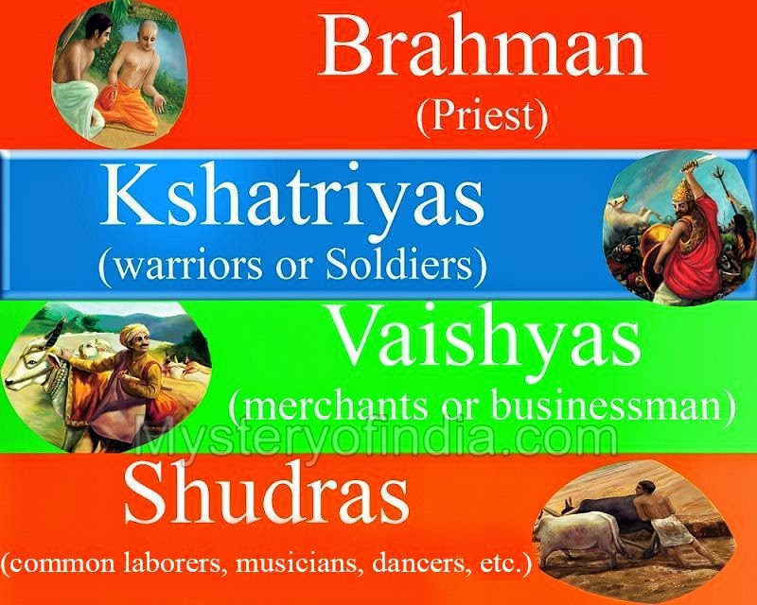
Society of Sindh
Caste system
Trade Relations
Rulers Beliefs
Easy to conquer

Slide 3

Why was it easy to conquer this region?
Greeks
Kushans
Huns
Sassanid Empire
Mangols

Slide 4
Causes of attack
The Rebellions of Khalifa kept by Dahir
The Plunder of Ship coming from Cylone (Srilanka)

Slide 5
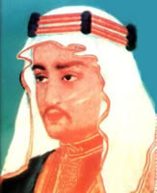
Expeditions
1st Expedition was led by Ubaidullah
2nd by Budail
Finally Muhammad Bin Qasim

Slide 6
Path of Conquests
Daibul (Bhanbhore) Brahman
Nerun (Hyderabad) Buddhist
Sewistan (Sehwan) Raja’s Cousin
Rawar (Raja Dahir)
Brahmanabad (Surrendered)
Alore (Besieged)

Slide 7
Effects of conquest
Educational Effects
Arab knowledge to Pak and vice versa
Astronomer studied at Banarus (Abu Mushahir)
Sidhanta translated into Arabic
Famous Mathematician Alkhuwarzimi translated

Slide 8
Effects of conquest
Religious
First time Muslims entered India as Conqueror
Liberty for practicing their religion

Slide 9
Effects of conquest
Social and Cultural
Arab learned Chess
Music influence
Language (Many Arabs learnt Sanskrit)
Many Families have Arab origin
Wadera is driven from Shaikh

Slide 10
Effects of conquest
Political
Shown weaknesses of Indians
Route of Muhammad Bin Qasim
Concept of Muslim State, liberty of religion, equality and continuance in local systems

Slide 11
Next Class
Chapter 12 and 14 from
A history of the people of Pakistan: Towards Independence.

